Slide 1
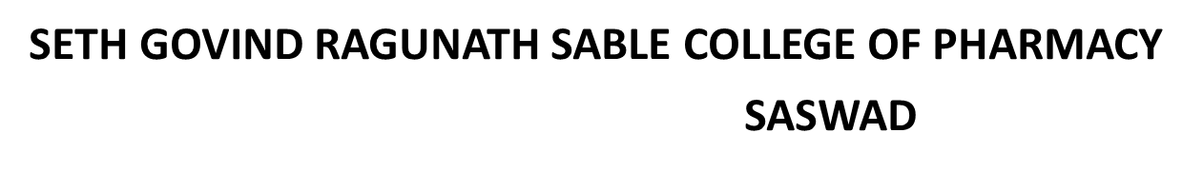


Antihyperlipidemic Drug

Slide 2
Hyperlipidemia
☞ Hyperlipidemia a broad term, also called hyperlipoproteinemia, is a common disorder in developed countries and is the major cause of coronary heart disease.
☞ It results from abnormalities in lipid metabolism or plasma lipid transport or a disorder in the synthesis and degradation of plasma lipoproteins.
Causes of hyperlipidemia
• Mostly hyperlipidemia is caused by lifestyle habits or treatable medical conditions.
• Obesity, not exercising, and smoking, diabetes, obstructive jaundice

Slide 3
The biochemistry of Plasma lipids What are lipids?
Lipids are the heterogenous mixtures of fatty acids and alcohol that are present in the body. The major lipids in the bloodstream are cholesterol and it’s esters, triglycerides and phospholipids.
Cholesterol
Is C27 steroid that serves as an important component of all cell membranes and important precursor molecule for the biosynthesis of bile acids, steroid hormones, and several fat-soluble vitamins
✓ It is necessary for new cells to form and for older cells to repair themselves after injury.
✓ Cholesterol is also used by the adrenal glands to form hormones such as cortisol, by the testicles to form testosterone, and by the ovaries to form estrogen and progesterone.

Slide 4
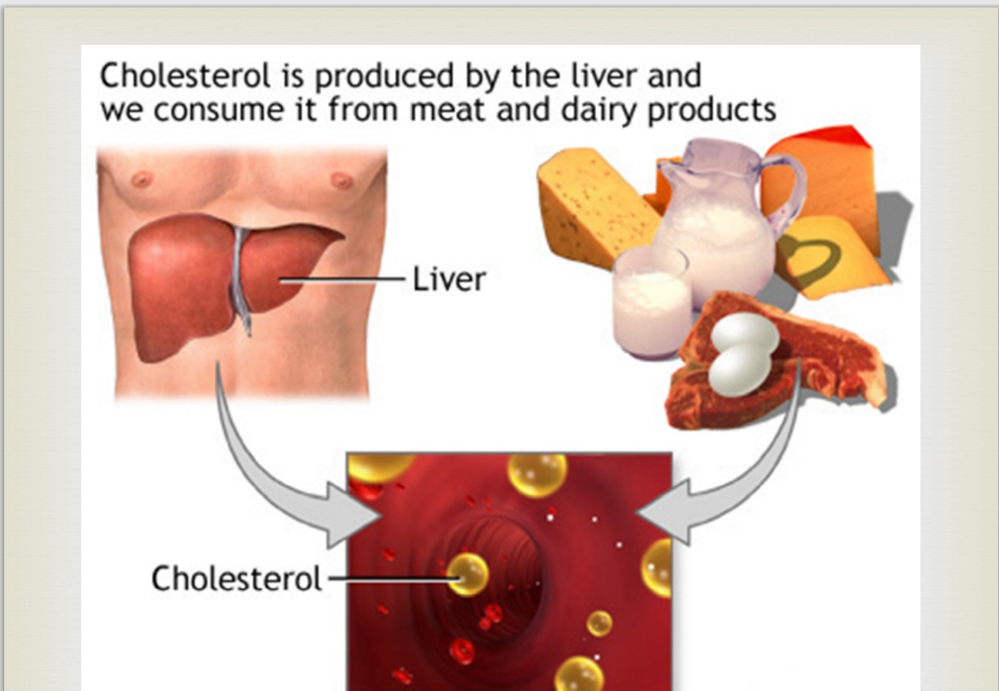

Slide 5
functions of triglycerides and Phospholipids in the body
• Triglycerides supply energy for the body. Triglycerides either meet immediate energy needs in muscles or stored as fat for future energy requirements.
• Phospholipids are compounds that are used to make cell membranes, generate second messengers, and store fatty acids for the use in generation of prostaglandins
Lipoproteins
✓Since blood and other body fluids are watery, so fats need a special transport system to travel around the body.
✓They are carried from one place to another mixing with protein particles, called lipoproteins.
✓There are four (or five) types of lipoproteins, each having very distinct job.

Slide 6
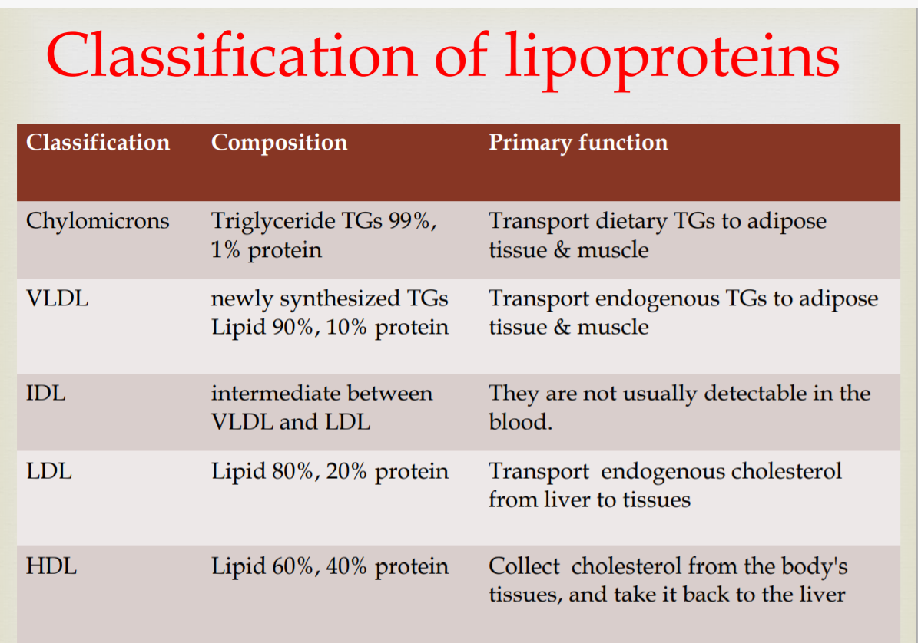

Slide 7
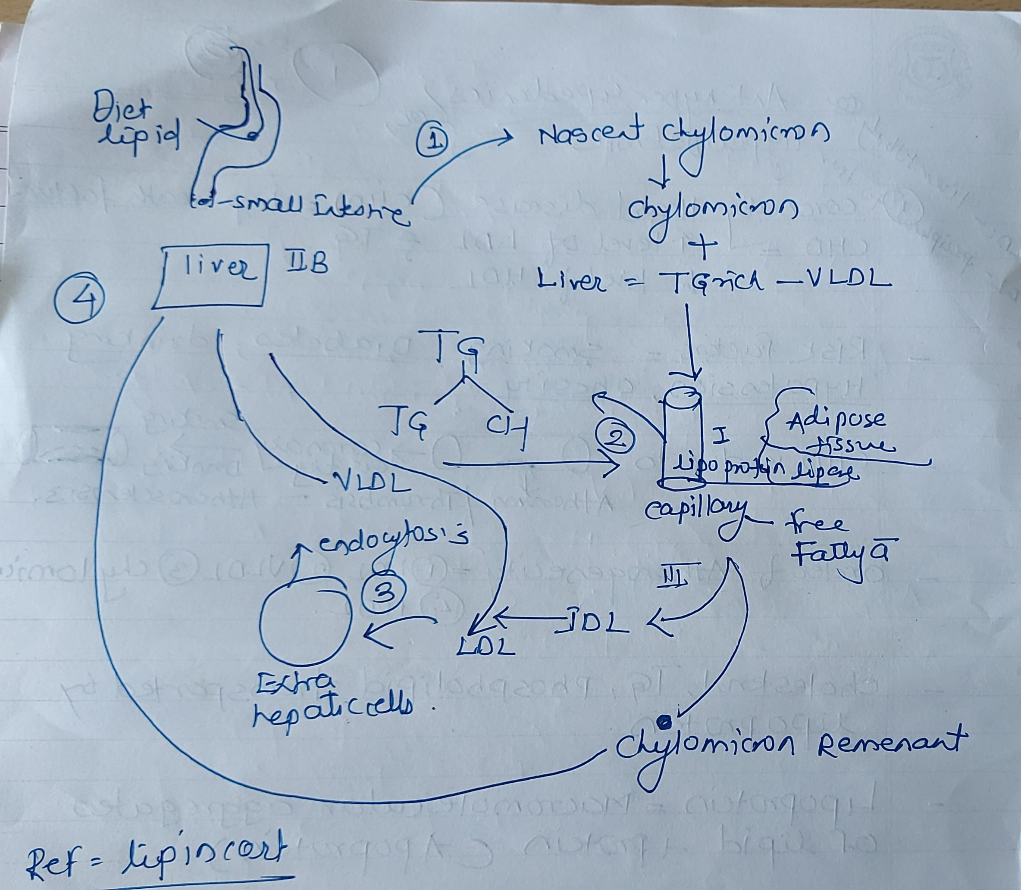
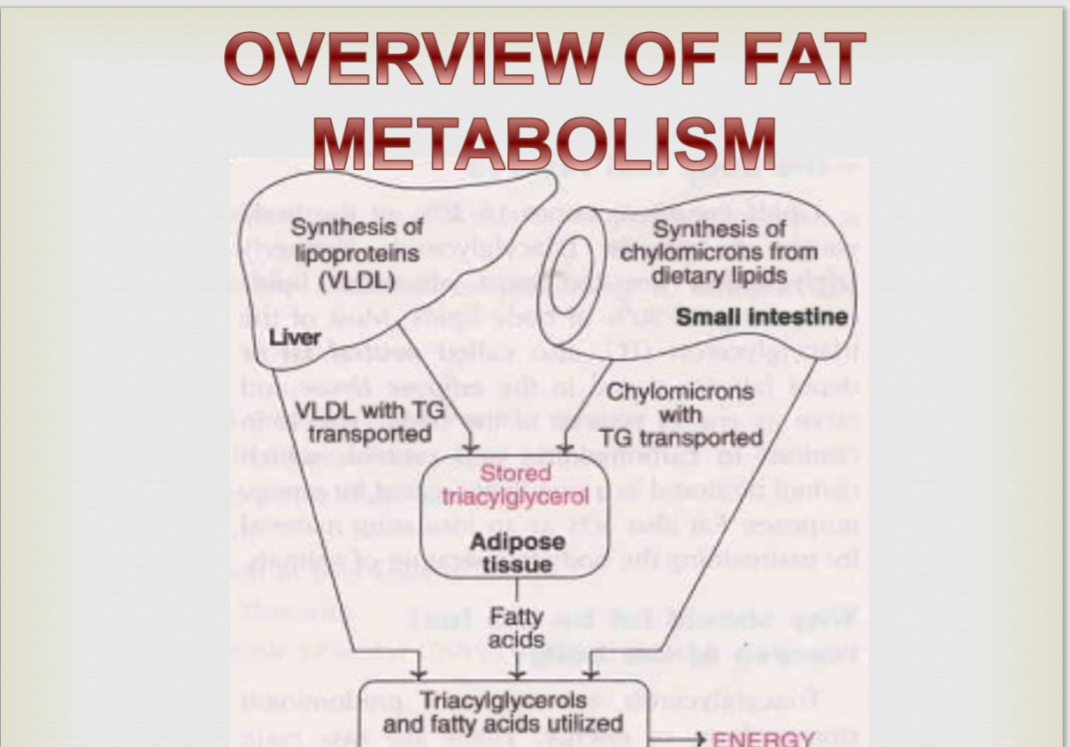

Slide 8
Classification of Hyperlipidemia

Slide 9
GROUPS OF HYPERLIPIDEMIA
Primary familial hyperlipoproteinemia
• Subclassified into six phenotypes I , IIa , IIb , III, IV, and V based on lipoproteins and lipids were elevated.

Slide 10

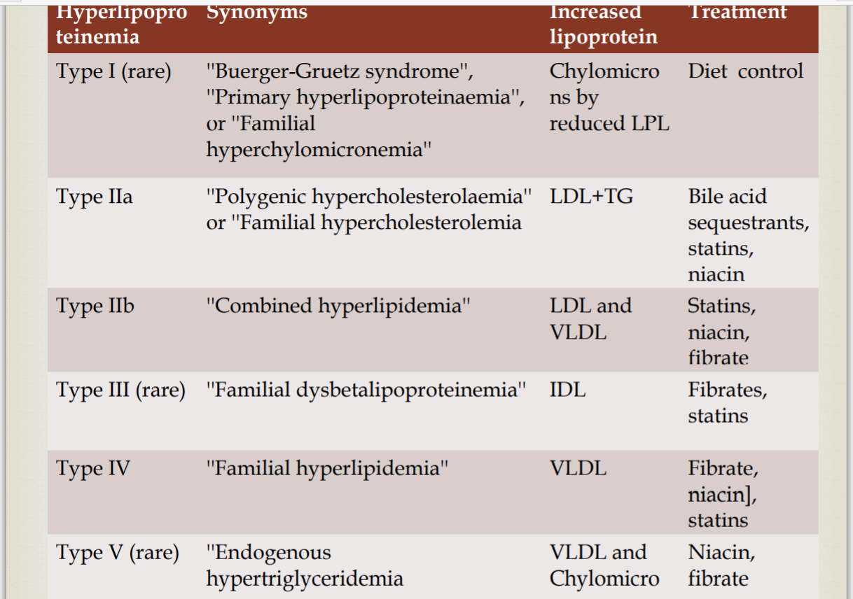

Slide 11
CLASIFICATION OF ANTI HYPERLIPIDEMIC DRUG
Several different classes of drugs are used to treat hyperlipidemia.
These classes differ not only in their mechanism of action but also in the type of lipid reduction and the magnitude of the reduction.

Slide 12
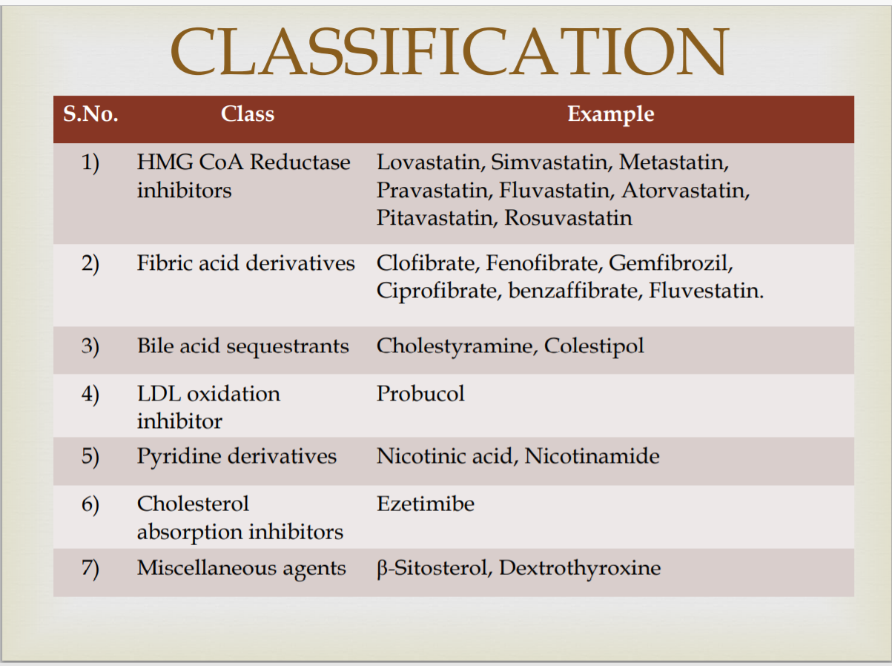

Slide 13
HMG –COA REDUCTASE INHIBITION
Target: HMG-CoA Reductase (HMGR)
 The enzyme that catalyzes the conversion of HMG-CoA to mevalonate.
 This reaction is the rate determining step in the synthetic pathway of cholesterol
Statin
Today, there are two classes of statins:
Natural Statins: Lovastatin(Manacor), Pravastatin (Pravachol), Simvastatin .
Synthetic Statins: Atorvastatin , Fluvastatin . Statins are competitive inhibitors of HMG-CoA reductase. They are bulky and “stuck” in the active site. This prevents the enzyme from binding with its substrate, HMGCoA.

Slide 14
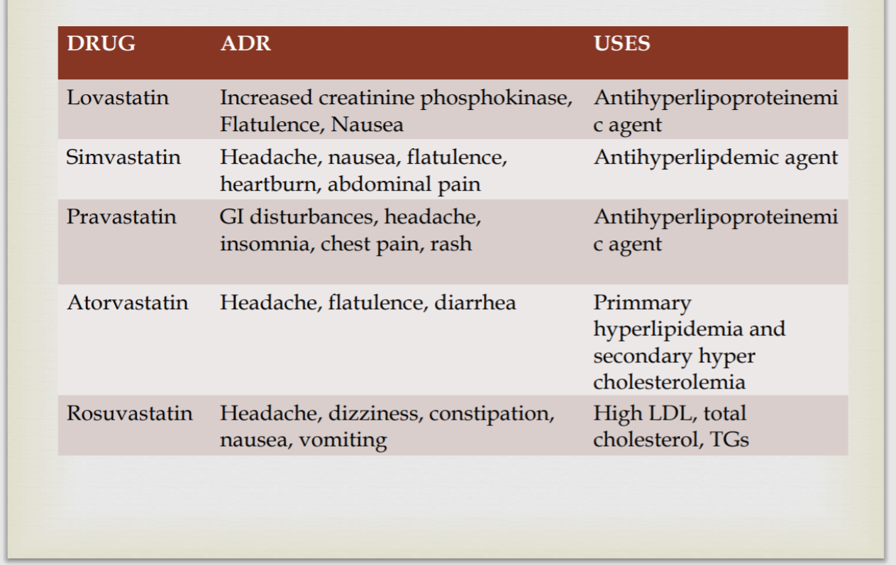

Slide 15
E.g LOVASTATIN, ATOVASTATIN,
Mechanism of action
HMG-CoA reductase catlyze synthesis of mevalonic acid from HMG-CoA and is the rate limiting step in cholesterole biosynthesis
Lead to up – regulation of LDL receptor in liver
Therapeutic uses
Great for all hyperlipidemias involving increased level; of LDL or cholesterol
Atherosclerosis ;stoke prevention
Primary prevention of CAD

Slide 16
Major side effect and drug interaction
Side effect
Headache
Nausea
Sleep disturbance
Elevation in hepatocellular enzymes and alkline phosphatase
Myosis and rhabdomyolysis , primarily when give with gemfibrozil or cyclosporine
Drug intraction
Lovastatine , atorvastatine ,rosuvastatin, and simvastatin potentiate effect of warfarin : this interaction is not seen with pravastatine , fluvastatine ,or pitavastatin

Slide 17
Bile acid sequestrants
Eg-Cholestyramine ,colestipol, colesvelam
Mechanism of action
Anion –exchange resin – bind bile acid in instestine limen prevention enterohepatic circulation ,this causes an up – regulation of hepatic LDL receptor and increased production of cholesterol
Therapeutic uses
USES hyperlipidemia involving ISOLATED INCREASIS OF LDL

Slide 18
Major side effect
Side effect
Constipation
Flatulence
Dyspepsia
Hypertriglyceridemia
Hyperchloremic acidosis
Bind many things which limits their absorption
Proxisting coagulopathy is a contraindication since they prevent absorption of vit K

Slide 19
FIBRATES
Examples : Gemfibrozil , Fenofibrate ,Micronized
Mechanism of action
Activation of nuclear transcription reception to increases LPL synthesis
Therapeutic use
DOC type 3 lipoproteinemia
Hypertriglyceridemia
Useful for pruritus in biliary obstruction

Slide 20
Major side effect and drug interaction
Side effect
Gastrointestinal
Myalgia
Lower blood cyclosporine level : potentially nephrotoxic in cyclosporine treated patient.
Potentiates warfarin action. Absorption of gemfibrozil diminished by bile acid sequestrants.

Slide 21
Nicotinic acid ( Niacin)
Examples ; Niacin,
Mechanism of action
Its is a potent inhibition of lipolysis in adipose tissues which decreases mobilization of FFAs to the liver which in turn decreases VLDL
Increases HDL level
Therapeutic use
Use Hyperlipidemia with very high VLDL and LDL
Patients with very low HDL

Slide 22
Major side effect and drug interaction
Side effect
Dry skin
Myositis
Prostaglandin – mediated cutaneous flushing , warm sensation
Headache
Rhabdomyolysis
Hyperuricemia

Slide 23
Cholesterol absorption inhibitors
Examples : Ezetimibe
Mechanism of action
Localizes at the brush border , selectively inhibits intestinal absorption of cholesterol and related sterols
Therapeutic use
Used in hypercholesterolemia together with statins and diet regulation
Side effect
Diarrhea
Abdominal pain
CL liver dysfunction

Slide 24
PCSK9 inhibitors
Examples : Alirocumab , Evolocumab ,
Proprotein convertase subtilistin kexin 9 is a serine protease produced predominantly in the that leads to the degradation of hepatocyte LDL receptors LDL –C levels
This category of lipid lowering therapy appears promising in a rang of clinical situations.
They are given subcutaneously
The major side effect is injection site reaction

Slide 25
DRUG THERAPY
If no improvement within 6 week with a single drug therapy ,the dose should be increased. If no improvement after 3 months chang the drug or consider combination therapy .
Bile acid resins can be safely combined with statins or nicotinic acid .
Fibrates acid and statins cl because of myopathy
Nicotinic acid and statins because of myopathy.

Slide 26
THANK YOU

